Slide 1
Planning Resources and Controlling Material Flow:

Slide 2
Planning Resources and Controlling Material Flow: Types of Planning Capacity Planning - Adjusting Capacity - Tactical Planning - Short-term Schedules- Material Requirements Planning -Extending the Role of MRP -Principles of Just-in-time -Achieving Just-in-time Operations -Extending JIT Along the Supply Chain

Slide 3
Learning outcomes
DISCUSS the role of planning in logistics
MEASURE the capacity of a supply chain
USE a standard approach to capacity planning
DISCUSS some practical difﬁculties with capacity planning
SEE how to design medium-term tactical plans
EXPAND the tactical plans into short-term schedules

Slide 4
TYPES OF PLANNING
Planning the supply chain starts with the logistics strategy, which gives the overall aims.
Capacity plans, which make sure there is enough capacity to meet long-term demand.
Aggregate plans, which give summaries of the work done in related activities, typically by month at each location.
Master schedules, which show a detailed timetable for all activities, typically by week.
Short-term schedules, which show detailed timetables for jobs and resources, typically by day.

Slide 5
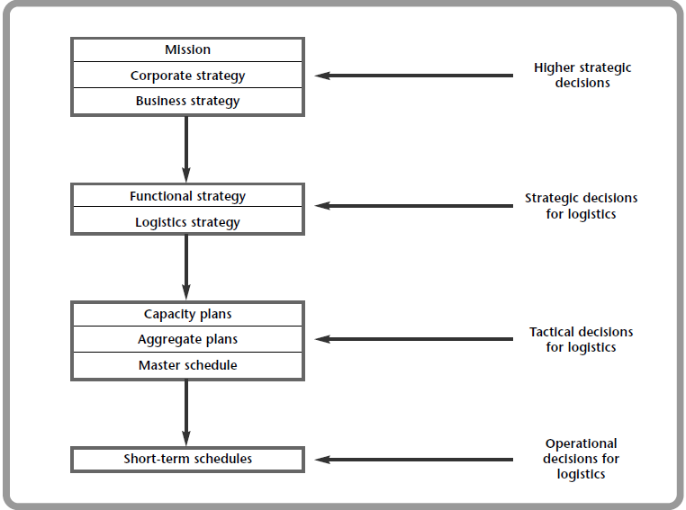
An approach to planning logistics

Slide 6
Capacity
The capacity of an operation is its maximum throughput in a speciﬁed time.
Sometimes the capacity seems obvious like number of seats in a bis and sometimes not clear like capacity of a super market
Capacity is an important concept for logistics, as it deﬁnes the maximum ﬂow through the supply chain in a given time.
designed capacity –maximum throughput under ideal condition
the effective capacity maximum throughput under realistic condition
ACTUAL THROUGHPUT is normally lower than effective capacity.

Slide 7
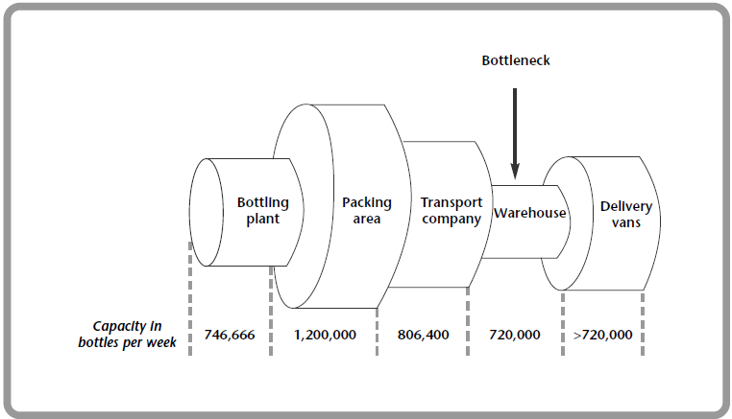
Bottlenecks in supply chain
Capacity of distribution at J&R Softdrinks

Slide 8
Matching capacity and demand
The aim of capacity planning is to match the available capacity of facilities to the demands put on them.
The main steps in capacity planning find the resources needed, compare these with the resources available, and then look at alternative plans for overcoming any differences. To be more specific, we:
1. examine forecast demand and translate this into a capacity needed
2. find the capacity available in present facilities
3. identify mismatches between capacity needed and that available
4. suggest alternative plans for overcoming any mismatch
5. compare these plans and find the best
6. implement the best and monitor performance.

Slide 9
Problems with capacity planning
demand comes in small quantities and can take almost any value, while capacity comes in large discrete amounts.
capacity can be increased by opening another shop, employing another person, using another vehicle, building another warehouse, and so on.
There is no way of exactly matching the discrete capacity to a continuous demand, so we have to use one of three basic strategies (as shown in Figure).

Slide 10
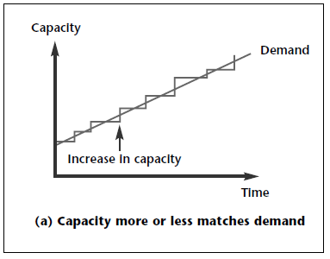

Slide 11
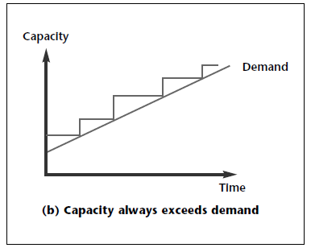

Slide 12
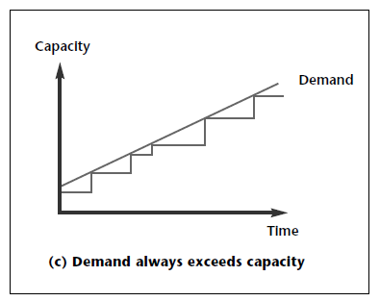

Slide 13
Each of these strategies is best in different circumstances. Factors that encourage an early increase in capacity include high cost of shortages, widely variable demand, varying efﬁciency, and low cost of spare capacity.
The main factor that encourages a delay before increasing capacity is the capital cost.

Slide 14
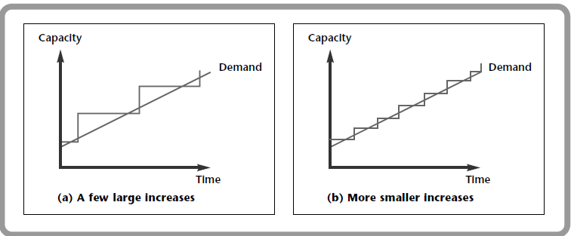
Alternative size of capacity expansion
A related question about changing capacity concerns the size of any changes. If you want to hire four new people over the next few months, should you recruit them all in one big campaign, or is it better to add them in smaller steps.

Slide 15
Alternative size of capacity expansion
The beneﬁts of large increases include longer periods without disruptions, less risk of not meeting unexpected demand, and the expansion might give economies of scale.
On the other hand, there is not such a close match to demand, disruptions may be more serious, capital costs are higher, utilisation is low, and there are risks if demand changes.

Slide 16
Short-term adjustments to capacity
These are clearly tactical and operational decisions. It is fairer to say, then, that capacity plan- ning includes decisions at all levels; strategic plans give the overall picture, modiﬁed by shorter term adjustments.
There are two ways of making these short-term adjustments to capacity:
capacity management adjusts capacity to match demand
demand management adjusts demand to match available capacity.

Slide 17
Short-term adjustments to capacity
Ways of adjusting capacity include:
changing the work pattern to match demand
employing part-time staff to cover peak demands
using outside contractors
renting or leasing extra facilities
adjusting the speed of working
rescheduling maintenance periods
making the customer do some work, such as packing their own bags in supermarkets.

Slide 18
Short-term adjustments to capacity
Ways to adjust demand include:
vary the price
limit the customers served, by demanding speciﬁc ‘qualiﬁcations’
change the marketing effort
offer incentives to change demand patterns, such as off-peak travel rates
change related products to encourage substitution, such as holiday destinations
vary the lead time
use a reservation or appointment system
use stocks to cushion demand.

Slide 19
Changing capacity over time
So far we have assumed that capacity is constant over time. In practice, the effective capacity of a supply chain can change quite markedly.

Slide 20
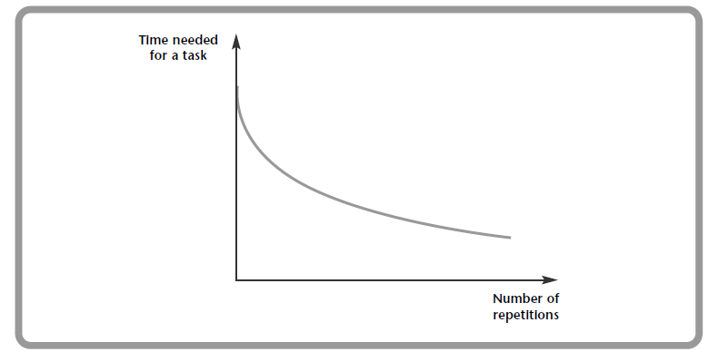
Changing capacity over time
more systematic changes in capacity. One of the most obvious is the effect of a learning curve. The more often you repeat something, the easier it becomes and the faster you can do it (as shown in Figure .
Number of repetitions | Time for the last (mins)
1 | 10.0
2 | 9.0
4 | 8.1
8 | 7.29
16 | 6.56
32 | 5.90
64 | 5.31
128 | 4.78

Slide 21
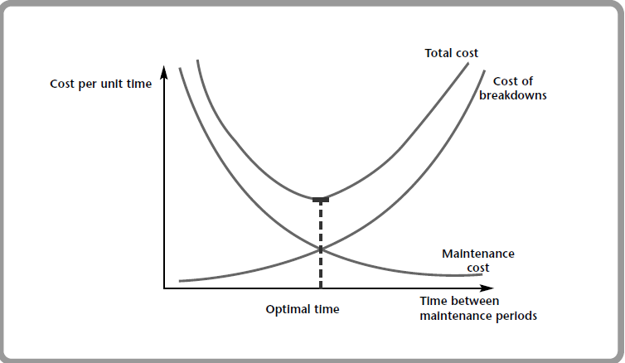
Changing capacity over time
Another reason for systematic changes in capacity comes from ageing equipment and facilities.
Cost of maintenance

Slide 22
TACTICAL PLANNING - Aggregate planning
Tactical plans bridge the gap between longer term strategic plans and operational details.
Different names are used for this level of planning, but the most common are aggregate plans and master schedules.
AGGREGATE PLANNING makes the tactical decisions that translate forecast demand and available capacity into schedules for families of activities.

Slide 23
Aggregate planning
aggregate planners are looking for answers to questions, like:
Should we keep throughput at a constant level, or change it to meet varying demand?
How should we use stocks to meet changing demand?
Should we vary the size of the workforce with demand?
Can we change work patterns to meet changing demand?
Should we use subcontractors or outside organisations to cover peak demands?
Can we allow shortages, perhaps with late delivery?
Can we smooth the demand?

Slide 24
Master Schedule
At the end of the aggregate planning, an organisation has schedules for its major types of activity, typically for each month, at each location. The next stage is to add more detail, and this is done in the master schedules.
The MASTER SCHEDULE gives a timetable for activities, typically for each week. Its aim is to achieve the activities described in aggregate plans as efﬁciently as possible.

Slide 25
Overall approach of tactical planning
Step 1 translate forecasts and other information into a demand for resources
Step 2 ﬁnd the resources currently available
Step 3 identify mismatches between resources needed and available
Step 4 suggest alternative plans for overcoming any mismatches
Step 5 compare these plans and ﬁnd the best
Step 6 implement the best plan and monitor performance.

Slide 26
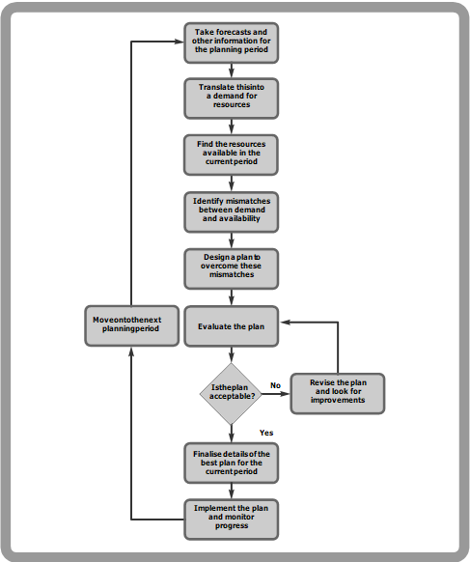
An iterative approach to planning

Slide 27
Generating alternative plans
There are many ways of generating alternative plans, ranging from simple intuition through to sophisticated mathematical models.
The following list shows the most common methods of generating plans.
Negotiations:
Adjust previous plans:
Other intuitive methods:
Graphical methods:
Spreadsheet calculations:
Simulation:
Expert systems:
Mathematical models

Slide 28
SHORT-TERM SCHEDULES
SHORT-TERM SCHEDULES give detailed timetables for jobs, people, materials, equipment and all other resources.
Short-term schedules give the sequences of activities, and the times when they should be done.
you might think that short-term scheduling is easy – but in practice it is notoriously difﬁcult
Imagine that you have ten jobs that you must ﬁnish today. In how many different ways can you arrange the ten jobs? -10 * 9 * 8 * 7 * 6 * 5 * 4 * 3 * 2 * 1 = 3,628,800

Slide 29
Approach to scheduling
Backward scheduling, where schedulers know when a job has to be ﬁnished. Then they can work back through all the activities to ﬁnd the date when the job must be started.
Forward scheduling, where schedulers know when a job can start. Then they can work forward through all activities to ﬁnd the date when the job will be ﬁnished.
These two approaches suggest general principles, but we need some way of ﬁnding the best order for jobs.

Slide 30
Approach to scheduling
If you have a number of jobs waiting to use a single piece of equipment, the total processing time is ﬁxed regardless of the order in which the jobs are scheduled (providing the set-up time for each job is constant, regardless of the job that was done previously). But the order of taking jobs does change other measures of performance. You can see this in the following four scheduling rules.
First come, ﬁrst served:
Most urgent job ﬁrst:
Shortest job ﬁrst:
Earliest due date ﬁrst:

Slide 31
REVIEW OF RESOURCE PLANNING
The logistics strategy gives the general shape of the supply chain. After this, tactical and operational plans are needed to manage the ﬂow of materials. Planning is essential, as it gives timetables for all the activities and resources in the supply chain.
Capacity is an important feature of a supply chain, as it sets the maximum amount of products that can be delivered to ﬁnal customers in a given time. The capacity of the whole chain is set by a bottleneck.
Capacity planning matches the available capacity to demand. Resource requirement planning gives a standard procedure which iteratively searches for a reasonable solution.

Slide 32
REVIEW OF RESOURCE PLANNING
There are many practical difﬁculties with organising the capacity, including discrete capacity size and changing capacity over time.
Capacity plans focus on the longer term, but with shorter term adjustments. They set the scene for more detailed tactical and operational planning.

Slide 33
REVIEW OF RESOURCE PLANNING
Tactical aggregate plans describe timetables for families of activities over the medium term. Master schedules add more details, giving plans for individual activities. Both of these can use the approach of resource requirement planning, with plans actually designed by different methods ranging from negotiation through to mathematical programming.
Short-term schedules give timetables for the resources that support the tactical plans. The most common approach to short-term scheduling uses simple rules to get reasonable solutions

Slide 35
Controlling the material flow
DESCRIBE the distinctive approach of material requirements planning
USE MRP to timetable orders and deliveries
DISCUSS the beneﬁts and disadvantages of MRP
EXTEND the MRP approach along the supply chain
DESCRIBE the principles of just-in-time operations
DESIGN kanban systems for controlling JIT
DISCUSS the beneﬁts and disadvantages of JIT
EXTEND JIT along the supply chain for efﬁcient consumer response

Slide 36
previous chapter we described an approach to planning logistics based on resource requirement planninga nd the result is a set of timetables showing what all the facilities, equipment, people and resources should do at any time.
This seems a reasonable approach, but it does have drawbacks. It is, for example, fairly rigid and can be slow to react to changing conditions.
A way of getting around these problems is to match the supply of logistics to actual demand.

Slide 37
In other words, we want some way of ﬁnding the known, actual demand rather than using unreliable forecasts. This might seem rather optimistic, but there are several circumstances when we know the actual demand in advance.
We can illustrate the ﬁrst of these with material requirements planning (MRP). This uses the master schedule to give a timetable for the delivery of materials.

Slide 38
Dependent and independent demand
The conventional approach to planning assumes that overall demand for a product is made up of individual demands from many separate customers. These demands are independent of each other, so the demand from one customer is not related to the demand from another customer.
There are, however, many situations where demands are not independent.
When a manufacturer uses a number of components to make a product, the demands for all components are clearly related, since they all depend on the production plan for the ﬁnal product. This gives dependent demand.

Slide 39
MATERIAL REQUIREMENTS PLANNING uses the master schedule, along with other relevant information, to plan the supply of materials.
It is used for dependent demand.

Slide 40
Comparison of stock levels for dependent and independent demand
An important difference between the two approaches is the pattern of material stocks.
With independent demand systems, stocks are not related to production plans so they must be high enough to cover any likely demand.
These stocks decline during operations, but are soon replaced to give the pattern shown in Figure (a).
With MRP, stocks are generally low but rise as orders are delivered just before operations starts.
The stock is then used during production and declines to its normal, low level. This pattern is shown in Figure (b).

Slide 41
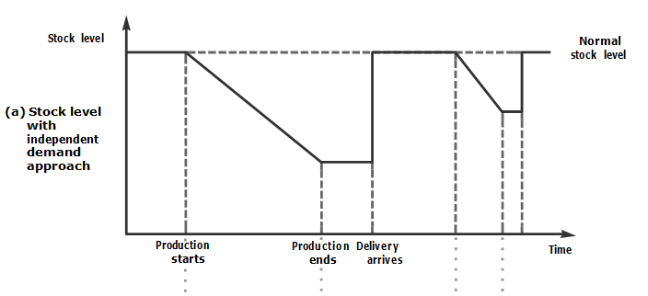
Comparison of stock levels for dependent and independent demand

Slide 42
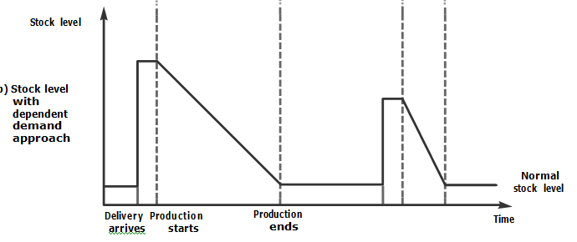
Comparison of stock levels for dependent and independent demand

Slide 43
The MRP approach
MRP uses a lot of information about schedules, products and materials. This comes from three main sources:
Master schedule, giving the number of every product to be made in every period
bill of materials, listing the materials needed for every product
inventory records, showing the materials available.

Slide 44
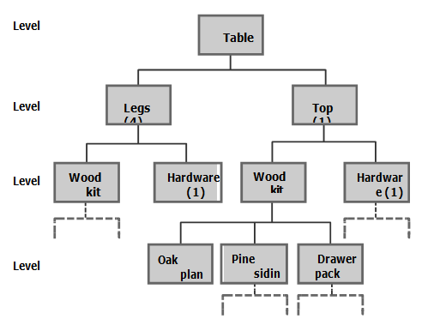
A bill of materials is an ordered list of all the parts needed to make a particular product.
Part of a bill of materials for a table

Slide 45
The MRP approach
Suppose a master schedule shows that the company plans to make 10 tables in February.
It obviously needs 10 tops and 40 legs ready for assembly at the beginning of February. In practice, these are the gross requirements.
The company may not have to order them all, as it may already have some in stock, or have outstanding orders that are due to arrive shortly.
If we subtract these from the gross requirements we get the net requirements for materials.
The company needs 40 table legs by the beginning of February, but if it already has 8 in stock and an order of 10 that is due to arrive in January, the net requirement is for 40 – 8 – 10 = 22.
Net requirements = gross requirements – current stock – stock on order

Slide 46
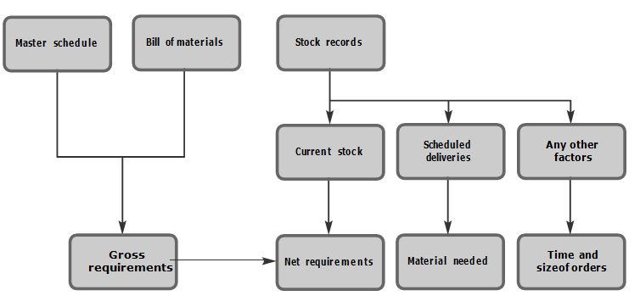
The MRP approach
Summary of MRP procedure

Slide 47
The MRP approach
MRP procedure is summarised by the following steps
Step 1: Use the master schedule to ﬁnd the gross requirements of level 0 items.
Step 2: Subtract any stock on hand and orders arriving to give the net requirements for level 0 items. Then schedule production, with starting times to meet these net requirements.
Step 3: Take the next level. Use the bill of materials to translate the net requirements from the last level into gross requirements for this level.
Step 4: Take each material in turn and:
subtract the stock on hand and scheduled deliveries to ﬁnd the materials needed
use the lead time and any other relevant information to give the size and timing of these orders.
Then if there are more levels of materials, go back to step 3.
Step 5: Finalise the timetable, adding any speciﬁc adjustments.

Slide 48
Disadvantages of MRP
Some general disadvantages of MRP include:
reduced ﬂexibility to deal with changes
needs a lot of detailed and reliable information
systems can become very complex
the order sizes suggested by MRP can be inefﬁcient
MRP may not recognise capacity and other constraints
can be expensive and time consuming to implement.

Slide 49
Extending MRP
We have outlined the basic approach of MRP and now can look at ways of improving the results.
For example, the basic procedure might suggest a series of small, frequent orders. It may be cheaper and more convenient to combine several of these small orders into one larger one. This is called batching.

Slide 50
There are four common methods of batching:
Lot for lot – where you order exactly the net requirement suggested by MRP for each period.
Fixed order quantity – where you ﬁnd an order size that is convenient, such as a truck load, a container load, or an economic order quantity
Periodic orders – where you combine the requirements over some ﬁxed period, and place regular orders for different quantities.
Batching rules – which uses a speciﬁc procedure to calculate the best pattern of orders. Typically they look for the combination of orders that gives the lowest overall cost. In practice, this can be quite a difﬁcult scheduling problem.

Slide 51
A more signiﬁcant extension to MRP adds feedback for planning.

Slide 52
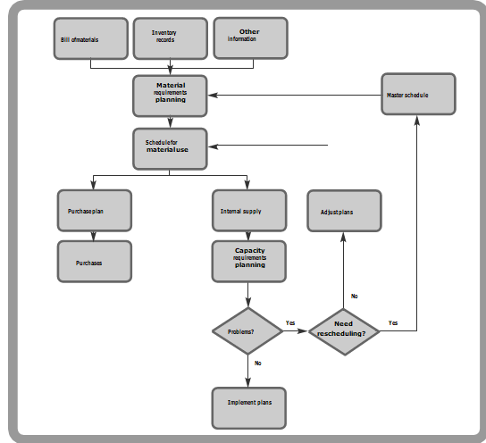
A closedloop MRP system

Slide 53
MRP II
With this approach, MRP would schedule all the operations.
However, there is no reason why we should stop there, and we could look at the associated ﬁnance, marketing, sales, human resource management, and so on.
Eventually we would get a completely integrated system that would use the master schedule as the basis for planning all the resources in an organisation. This is the aim of MRP II.
MRP II gives an integrated system for synchronising all functions within an organisation.
It connects schedules for all functions and resources back to the master schedule.

Slide 54
ERP
MRP II can generate plans for all activities and material movements within an organisation. But this is still not the end of the story. Following the trend for integrating the supply chain, we can extend the planning to other organisations. This gives the basis of Enterprise Resource Planning (ERP).

Slide 55
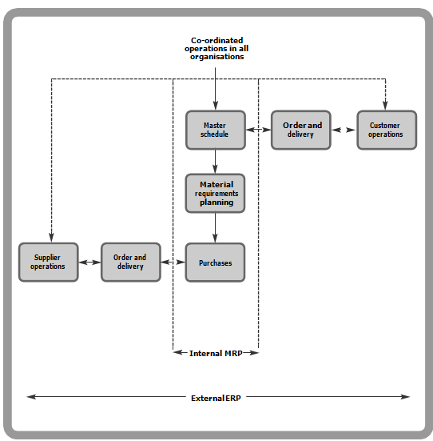
ERP

Slide 56
JUSTINTIME
So what happens when there really is a mismatch between supply and demand? What does a supermarket do when it sells loaves of bread one at a time, but gets them delivered by the truckload?
The traditional answer is to hold enough stock to cover the mismatch – the super market puts the truckload of bread on its shelves until it is sold or goes stale. JIT says that this is a mistake.
JUSTINTIME systems organise materials to arrive just as they are needed.
By coordinating supply and demand, they eliminate stocks of raw materials and work in progress.

Slide 57
JIT’s view of stock:
Now we can summarise JIT’s view of stock:
Stocks are held to cover short term mismatches between supply and demand.
These stocks serve no useful purpose – they only exist because poor coordination does not match the supply of materials to the demand.
As long as stocks are held, there are no obvious problems and no incentive for managers to improve the ﬂow of materials.
Then operations continue to be poorly managed, with problems hidden by stocks.
The real answer is to improve operations, ﬁnd the reasons for differences between supply and demand, and then take whatever action is needed to overcome the differences.
As you can see, JIT is based on very simple principles. Instead of holding stocks to allow for problems, you identify the problems and solve them.

Slide 58
Wider effects of JIT
In this wider sense, JIT sees an organisation as having a series of problems that hinder efﬁcient operations.
This approach leads to a number of changes in viewpoint.
Stocks: JIT assumes that these stocks actually hide problems.
Quality -JIT recognises that all defects have costs, therefore “nodefects”
Suppliers - JIT relies totally on its suppliers – so it supports the view of customers and suppliers working closely together

Slide 59
Batch size: JIT looks for ways of reducing the batch size so that it more closely matches demand.
Lead times: JIT aims for small, frequent deliveries with short lead times.
Reliability: JIT is based on continuous, uninterrupted production, so all operations must be reliable.
Employees: All employees should be treated fairly and equitably.

Slide 60
Beneﬁts and disadvantages of JIT
JIT gives the following beneﬁts:
lower stocks of raw materials and work in progress
shorter lead times
shorter time needed to make a product
higher productivity
higher equipment capacity and utilisation
simpliﬁed planning and scheduling
less paperwork
improved quality of materials and products
less scrap and wastage
better morale and participation of the workforce
better relations with suppliers
emphasis on solving problems in the process.

Slide 61
speciﬁc problems listed by JIT users include
high risks of introducing completely new systems and operations
initial investment and cost of implementation
long time needed to get signiﬁcant improvements
reliance on perfect quality of materials from suppliers
inability of suppliers to adapt to JIT methods
need for stable production when demand is highly variable or seasonal

Slide 62
speciﬁc problems listed by JIT users include
reduced ﬂexibility to meet speciﬁc, or changing, customer demands
difﬁculty of reducing setup times and associated costs
lack of commitment within the organisation
lack of cooperation and trust between employees
problems linking JIT to other information systems, such as accounts
need to change layout of facilities
increased stress in workforce
inability of some people to accept devolved responsibilities.

Slide 63
EXTENDING JIT ALONG THE SUPPLY CHAIN
This extension of JIT along the supply chain is known by a variety of names, including quick response (QR), continuous replenishment planning (CRP) and more commonly efficient consumer response (ECR).
EFFICIENT CONSUMER RESPONSE pulls materials through tiers of organ isations in the supply chain.
It is not necessarily physical transport that slows the ﬂow of materials through a supply chain, but the associated ﬂow of information.

Slide 64
ECR
ECR relies on a string of ‘enablers’
ECR only really works when organisations and their suppliers are working together in partnerships. This allows full EDI including purchase orders, invoices, planning information, pointofsales data, fund transfer, and so on.
Each organisation’s control system sends a message to suppliers and signals the need for more materials using an ‘electronic kanban’.

Slide 65
ECR
There is no point in having a sophisticated signalling system if the physical delivery of materials is slow. So ECR relies on very fast movement of materials.
In different circumstances there can be many other enablers for ECR. These include integration of the whole supply chain, transparency (so that all organisations can see what is happening and how this affects them), understanding the operations of other organisations (particularly the conditions and constraints they work with), ﬂexible operations that can deliver materials with short lead times, balanced resources to give a smooth ﬂow of materials, and so on.

Slide 66
Implementing ECR
The following list includes some key stages for an organisation implementing ECR:
design a logistics strategy based on responsive replenishment
understand the principles of ECR and how this will affect operations
deﬁne the aims of ECR for the organisation and measures of performance from partner ships with organisations that can match the organisation’s aims
introduce comprehensive EDI with suppliers and customers
build ‘ﬂow through’ logistics, where materials are moved as efﬁciently as possible
benchmark other operations and continue to improve.

Slide 67
REVIEW
The traditional approach to planning is based on forecasts of demand. When actual demand is known, we can use approaches based on ‘dependent demand’.
Material requirements planning is a dependent demand system which ‘explodes’ a master schedule to give timetables for the delivery of materials. By relating deliveries to actual requirements, MRP can both reduce costs and improve customer service.

Slide 68
REVIEW
There are several extensions to MRP, such as closedloop MRP which gives feedback for capacity planning. MRP II extends the idea of MRP to other functions, so that all plans within an organisation are related back to the master schedule.
Enterprise resource planning extends the MRP approach to suppliers. It co ordinates the movement of materials along the supply chain.

Slide 69
REVIEW
Justintime aims at eliminating waste from an organisation. It does this by organising operations to occur just as they are needed. This needs a new way of thinking, which solves problems rather than hides them.
JIT matches the supply of materials to the demand by ‘pulling’ materials through the process. Kanbans give a simple, practical method of controlling this ﬂow.

Slide 70
REVIEW
Efﬁcient consumer response extends the ideas of JIT, by pulling materials through an integrated supply chain. There are several enablers for ECR, including EDI and ‘ﬂow through’ logistics.

Slide 71
UNIT III OVER

